Slide 1
計算物理
頻譜分析

Slide 2
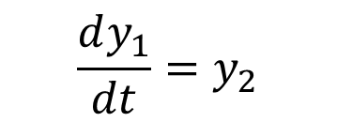
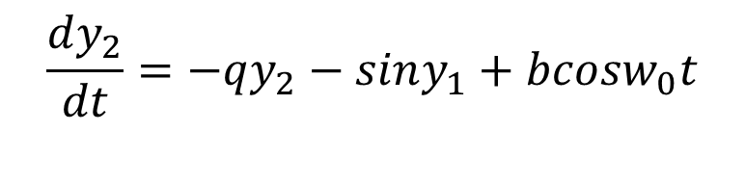

Problem
$$\frac{dy_{1}}{dt}=y_{2}$$
Using Fourth-Order-Kutta method to Cucalate the y.
Then use DFT(decrease fourier transform) to show the spectrum varies.
Then compare different range and N.
$$\frac{dy_{2}}{dt}=−qy_{2}−siny_{1}+bcosw_{0}t$$
$$w_{0}=\frac{2}{3}，q=0.5，b=0.9/1.15$$

Slide 3
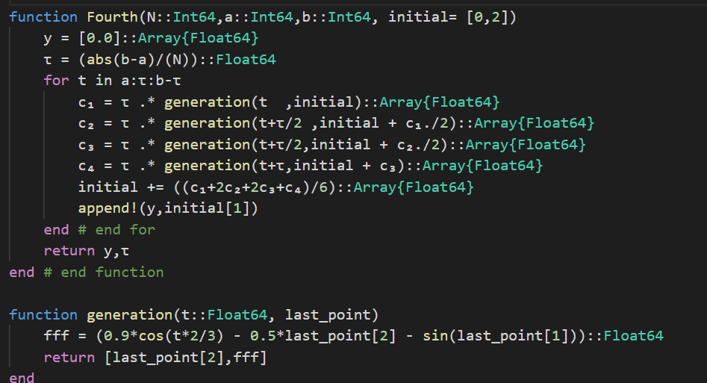
The Fouth-Order-Runge-Kutta code

Slide 4
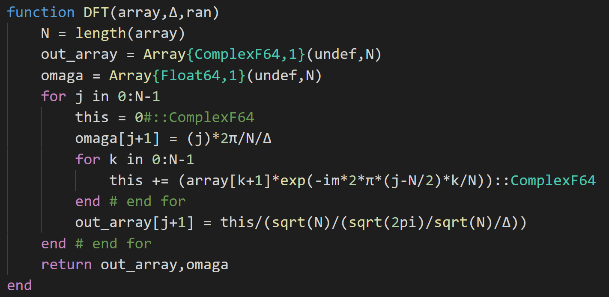
The DFT code

Slide 5
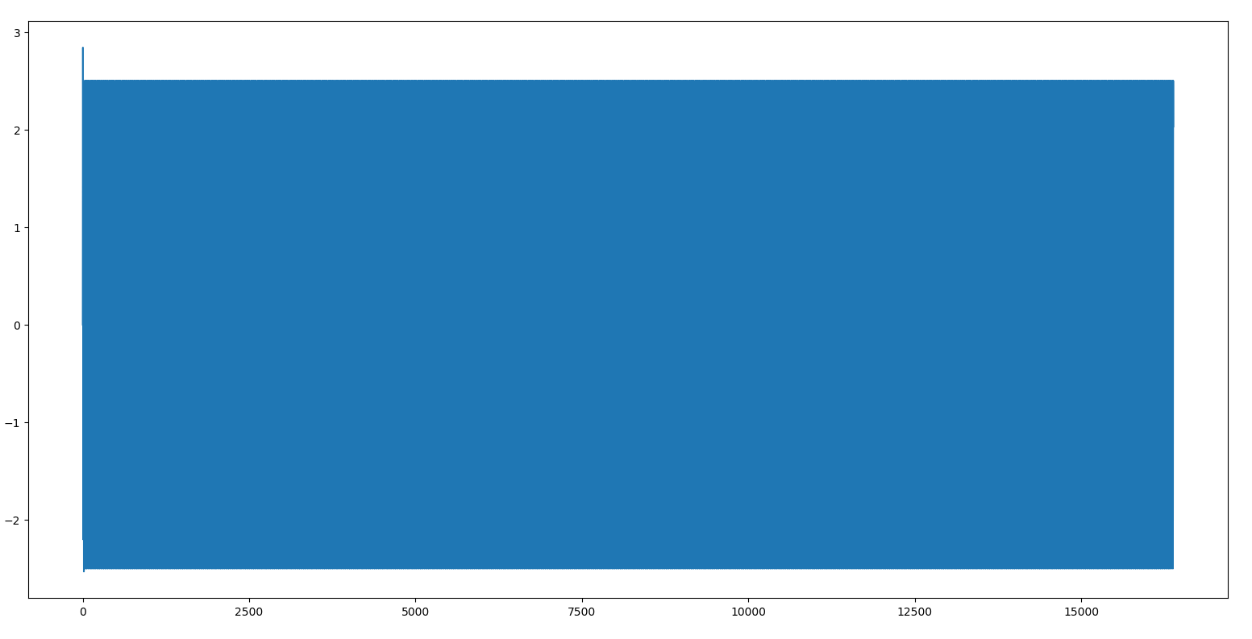
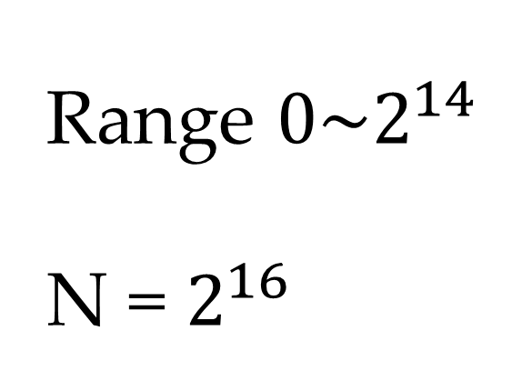
Fouth-Order-Runge-Kutta result
Range $0\sim 2^{14}$
N = $2^{16}$

Slide 6
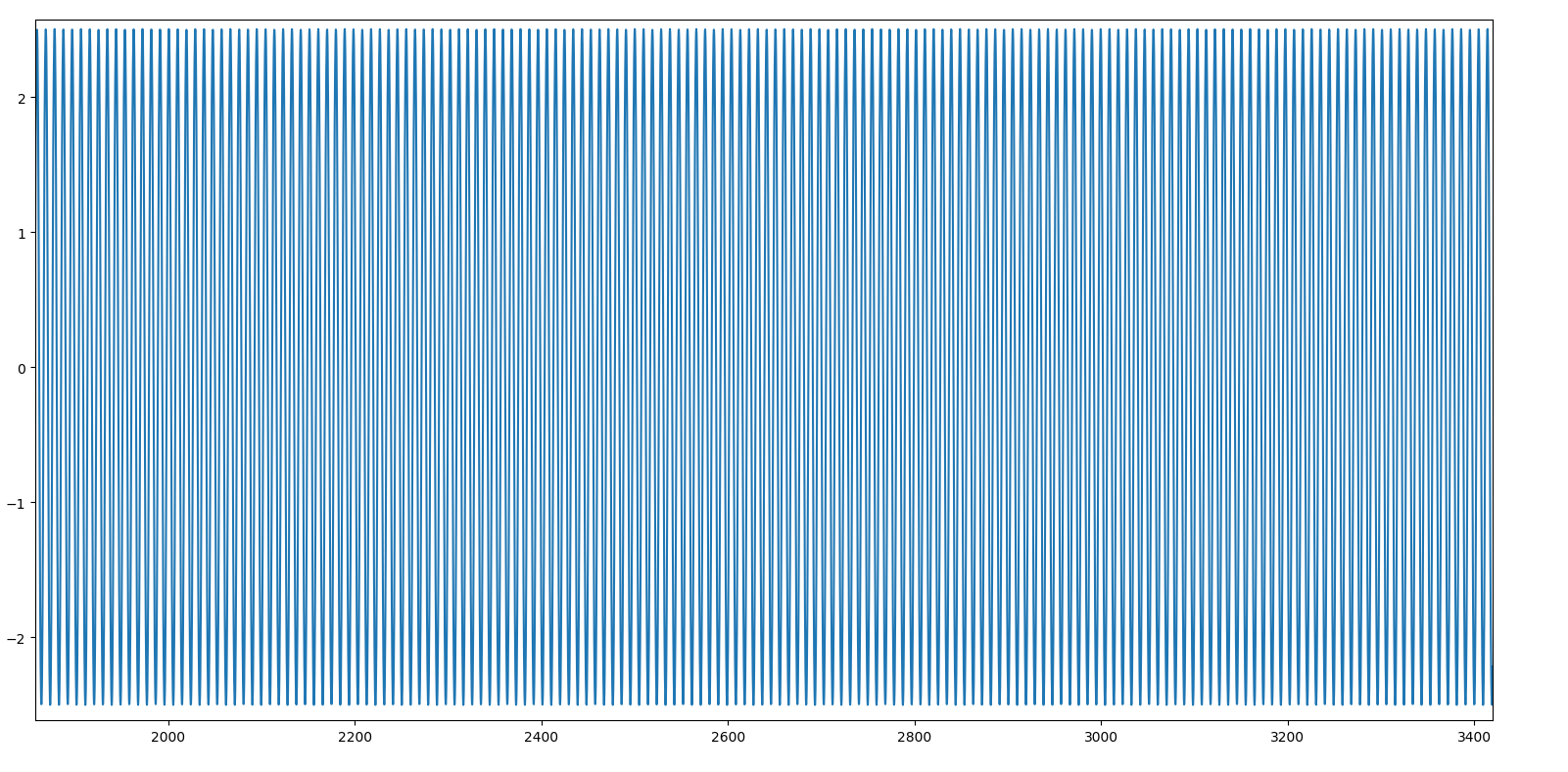
ZOOM UP

Slide 7
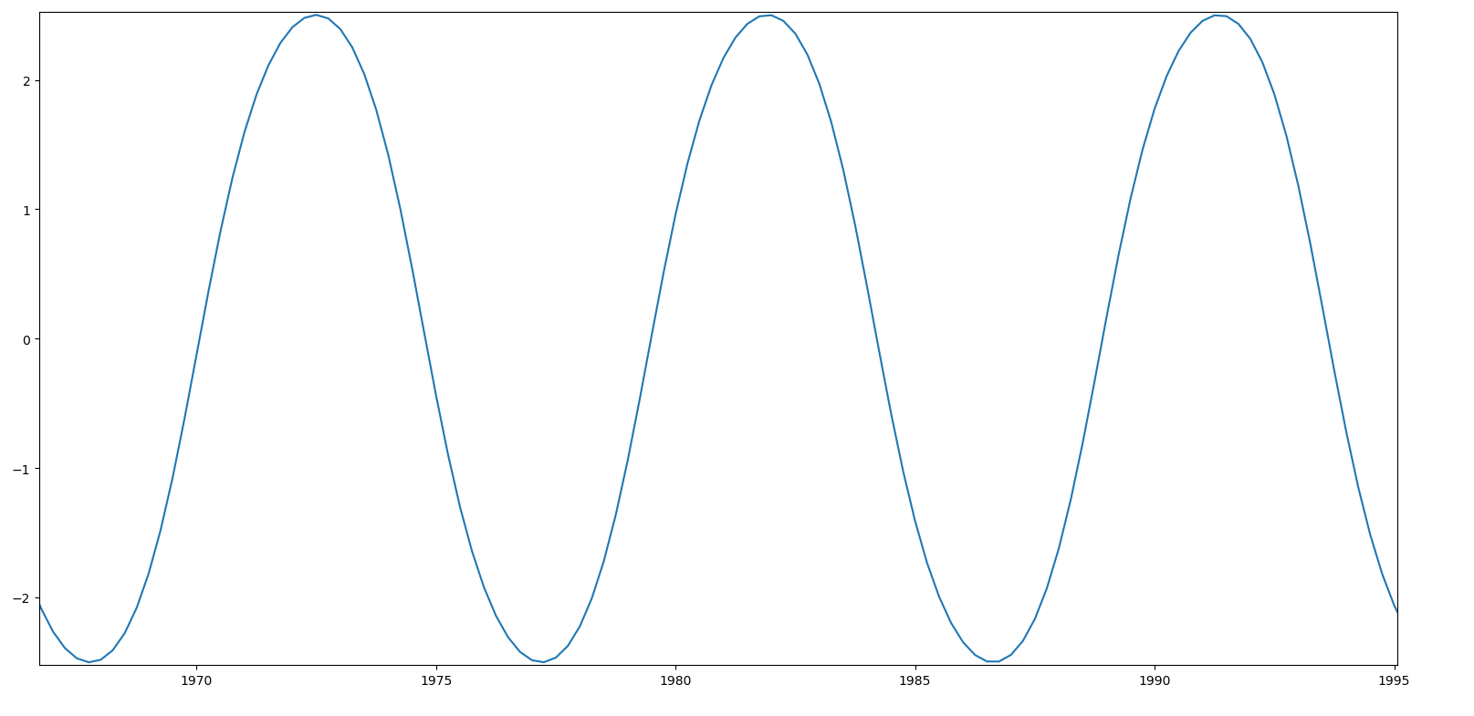
ZOOM UP AGAIN

Slide 8
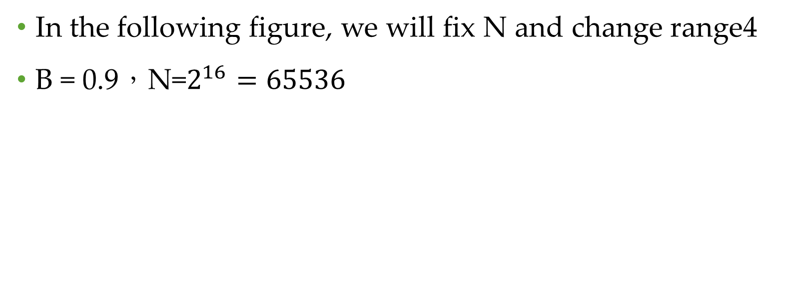
Fixed N
In the following figure, we will fix N and change range4
B = 0.9，N=$2^{16}=65536$

Slide 9
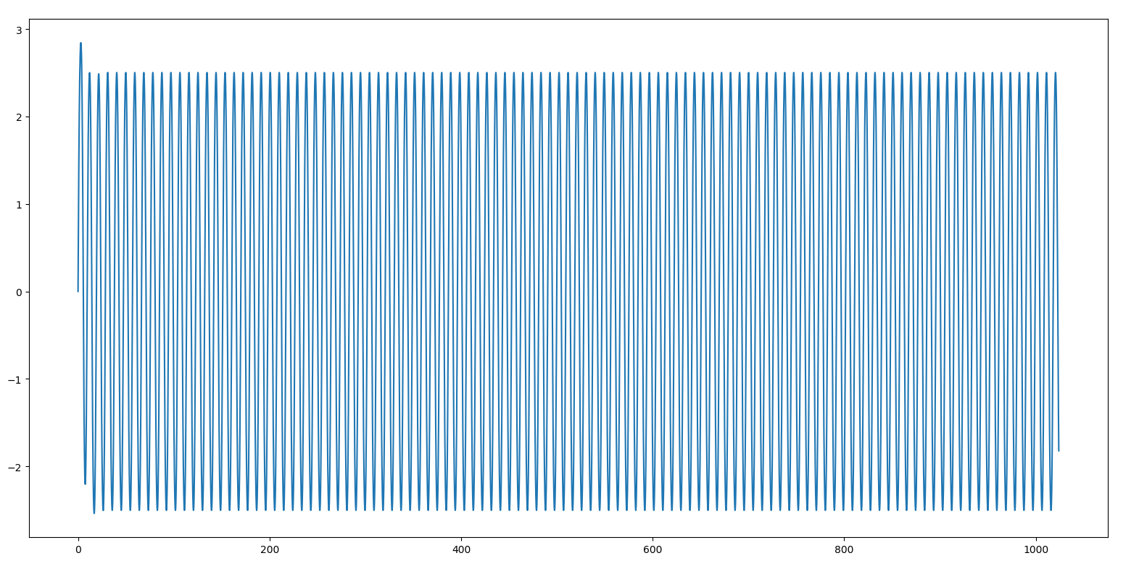
0~1024

Slide 10
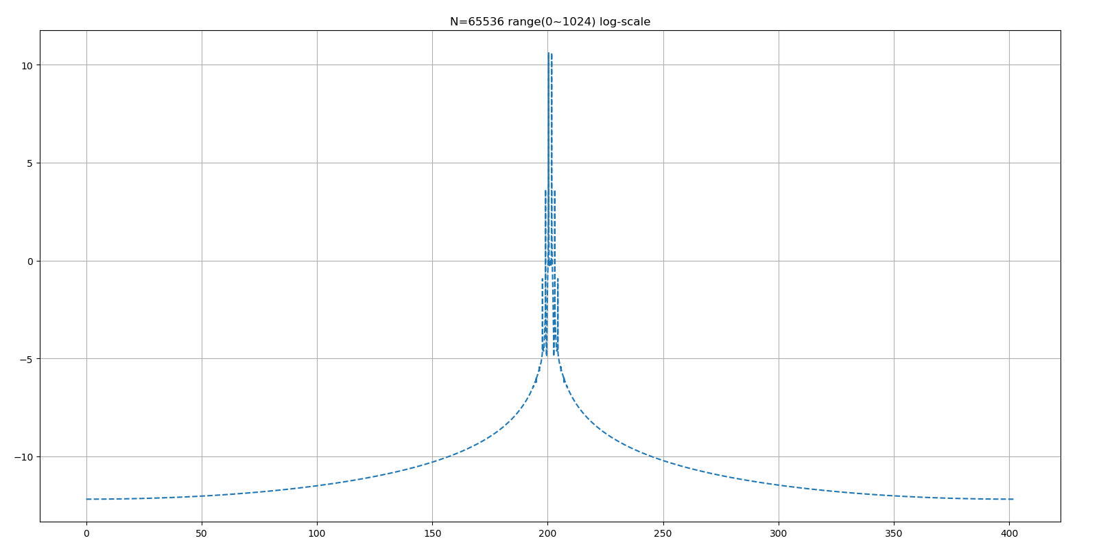

Slide 11
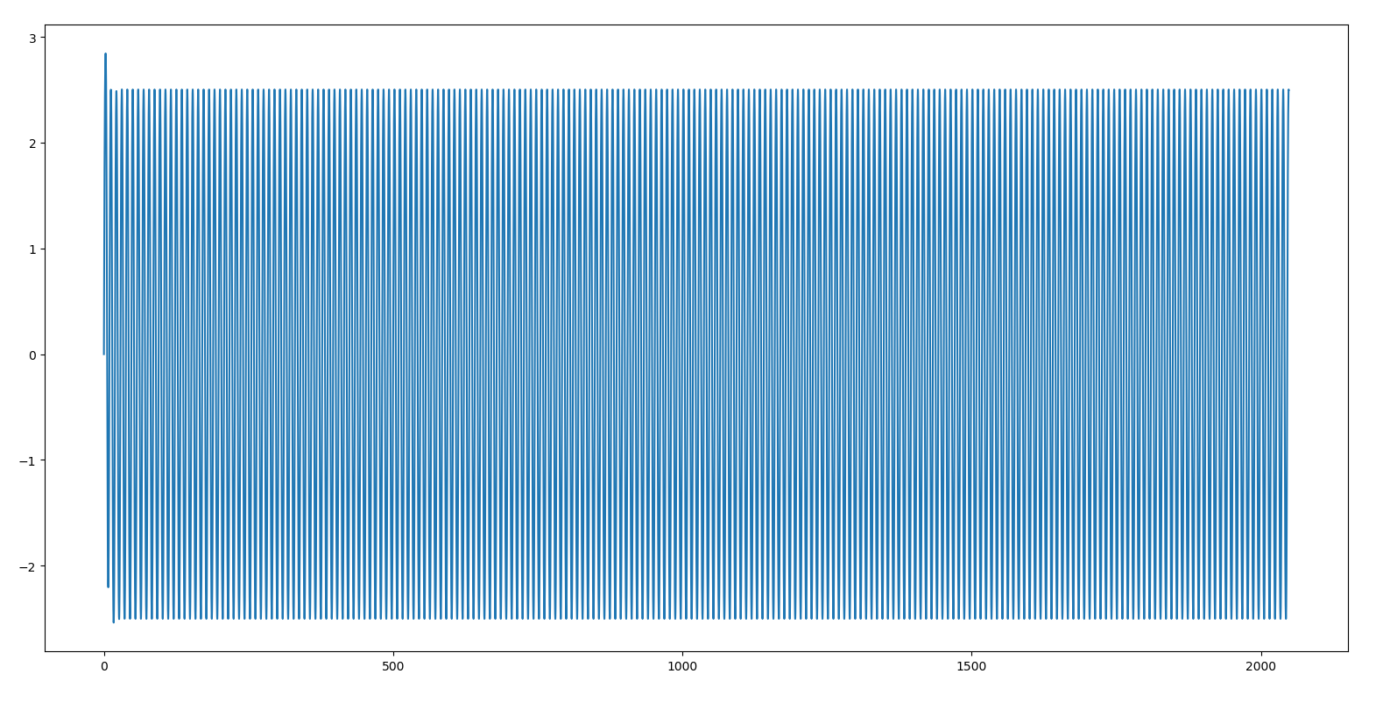
0~2048

Slide 12
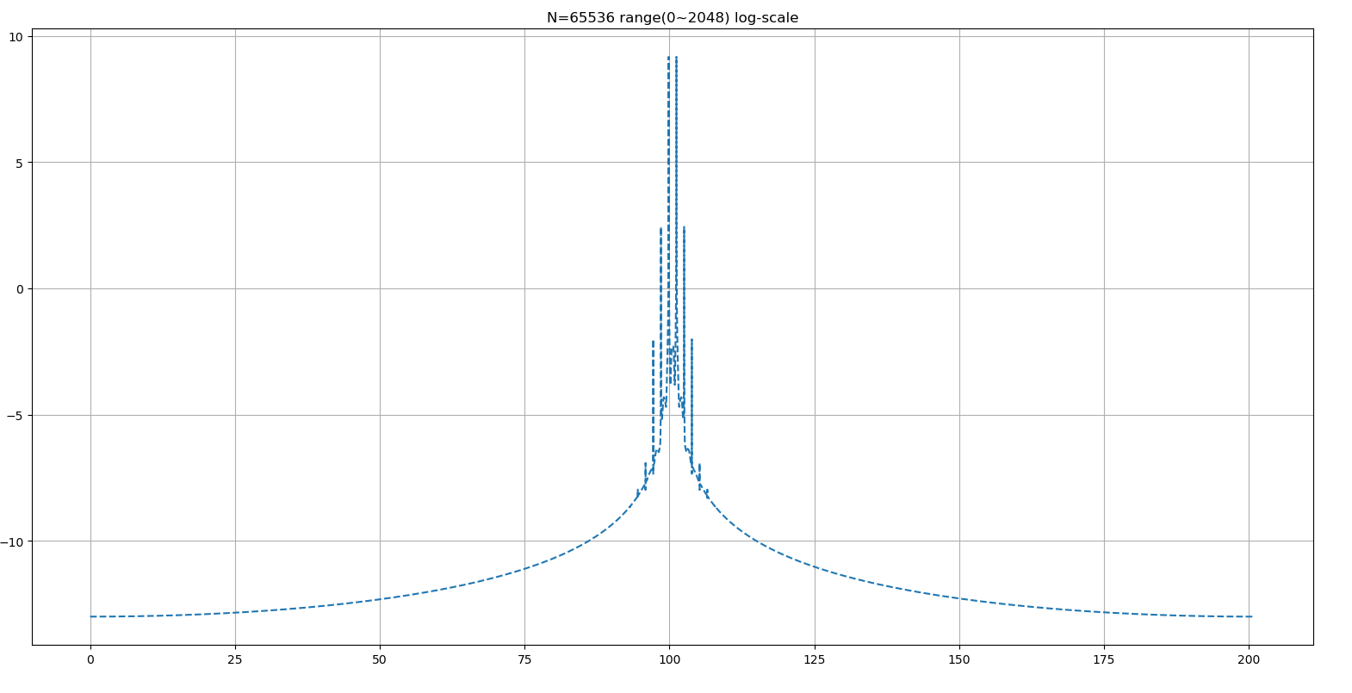
0~2048

Slide 13
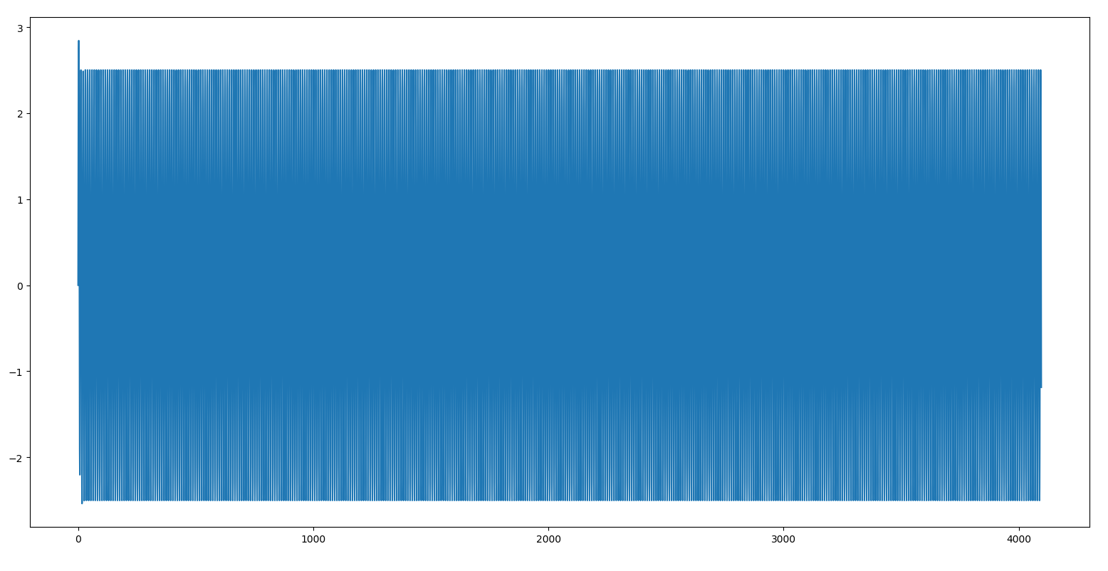
0~4096

Slide 14
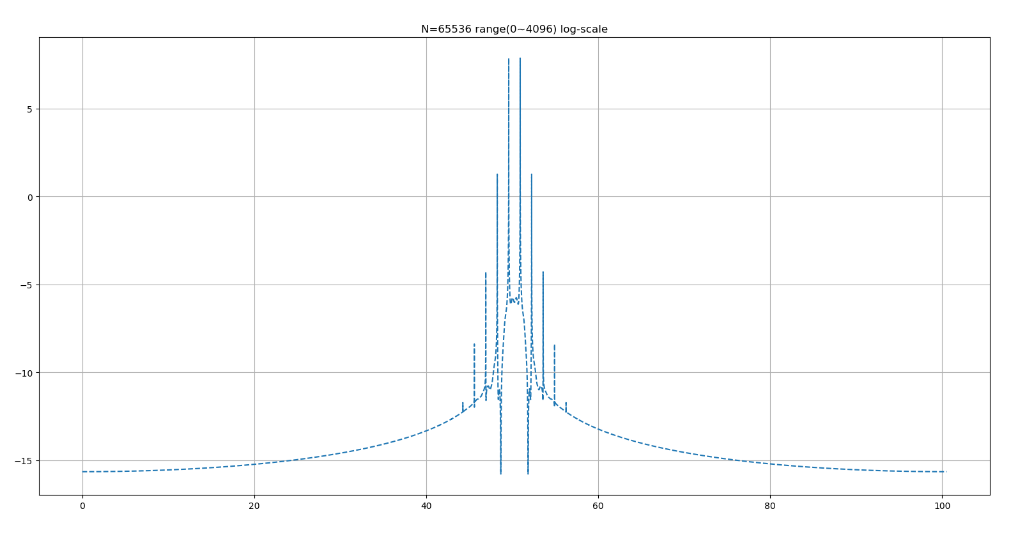

Slide 15
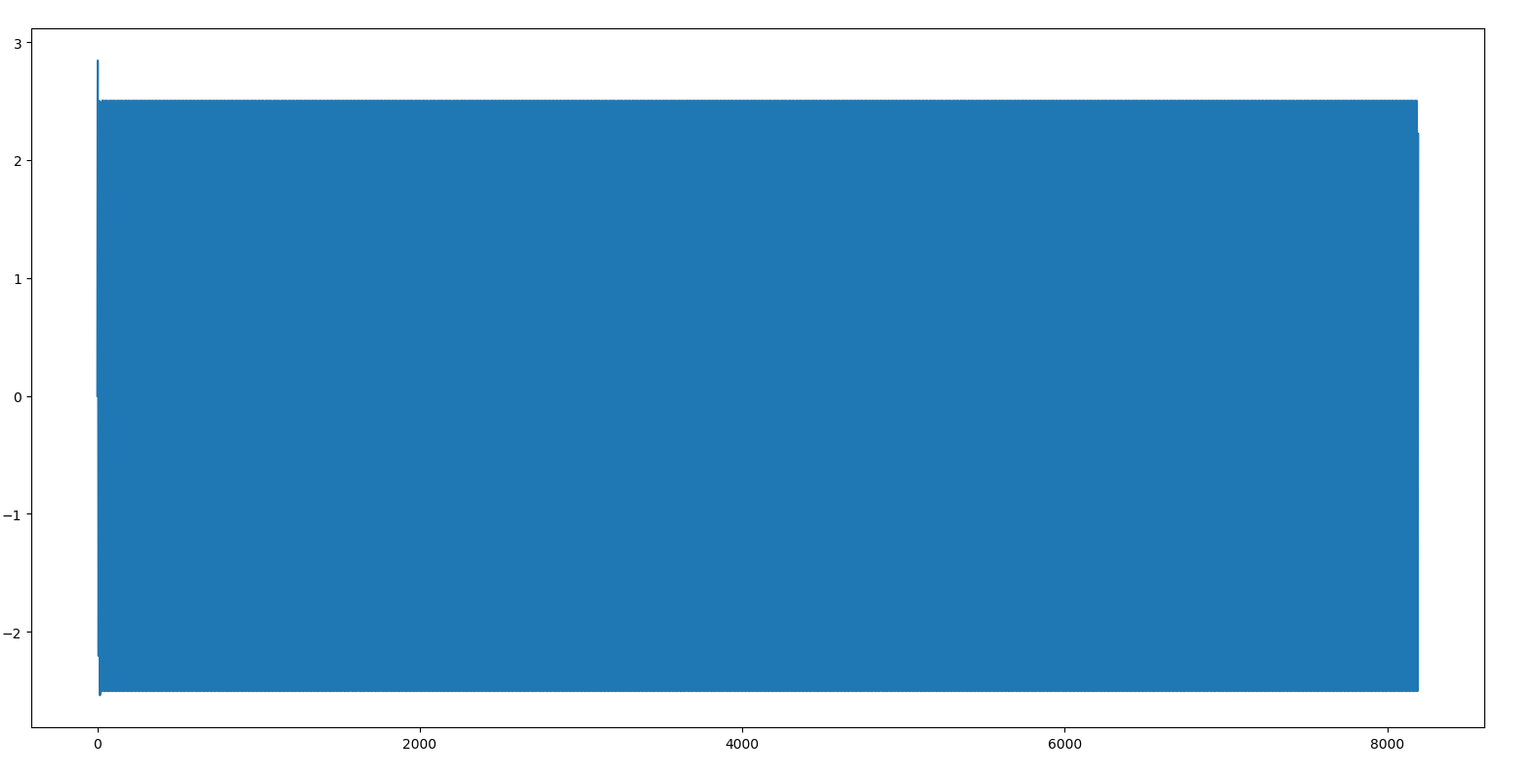
0~8192

Slide 16
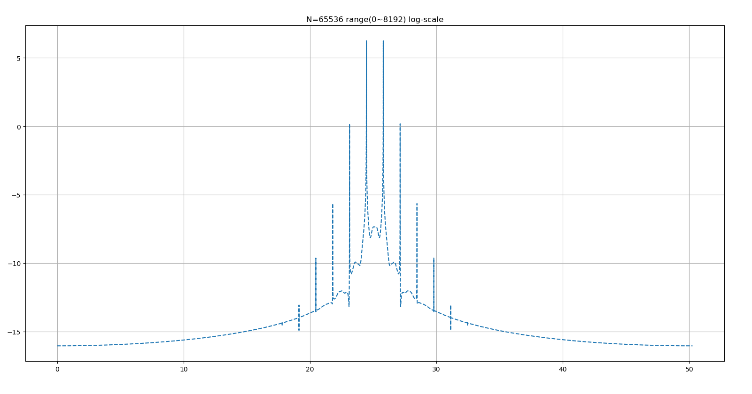

Slide 17
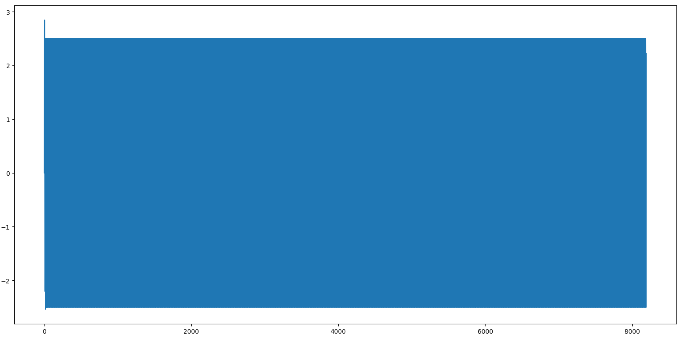
0~16384

Slide 18
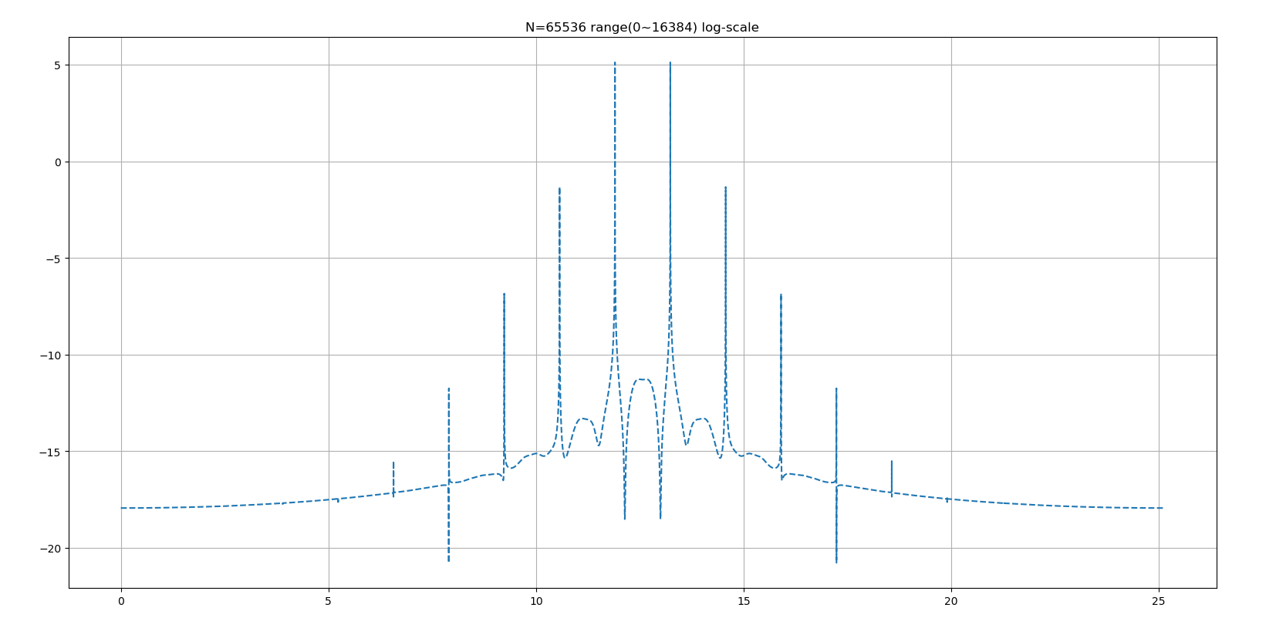

Slide 19
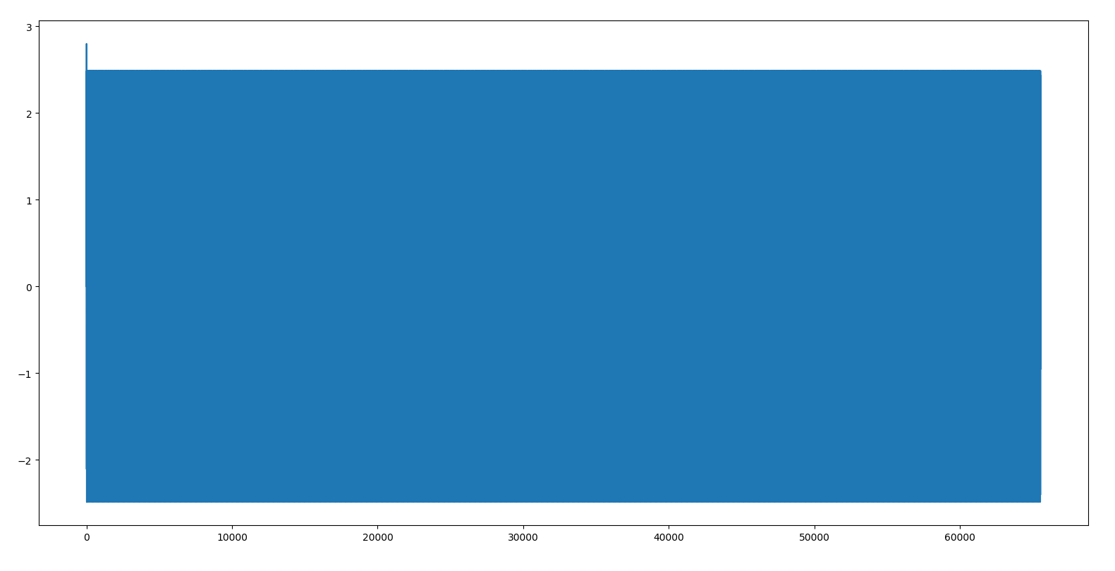
0~65536

Slide 20
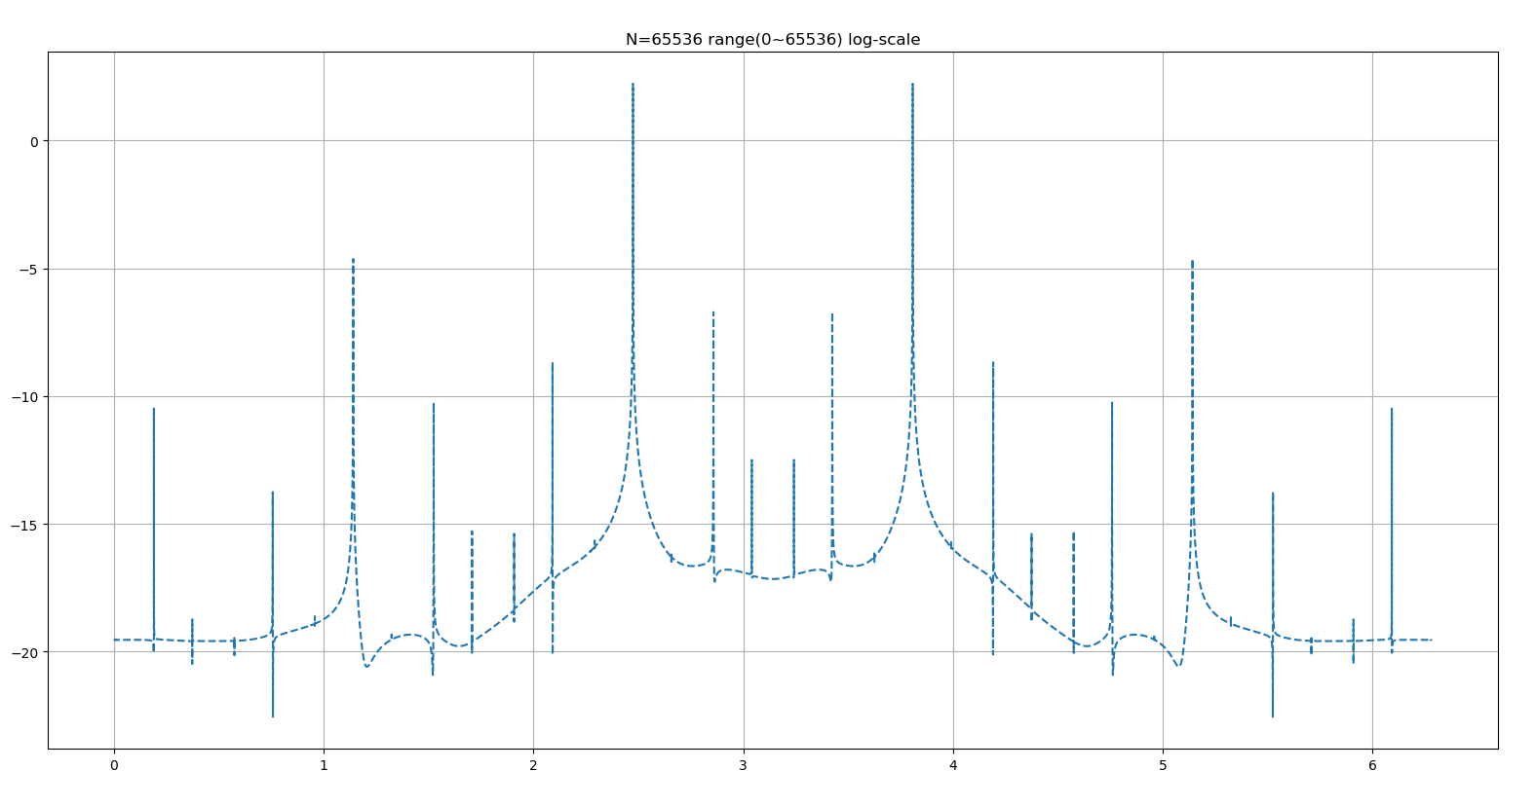

Slide 21

Fixed N
In the following figure, we will fix N and change range4
B = 1.15，N=$2^{16}=65536$

Slide 22
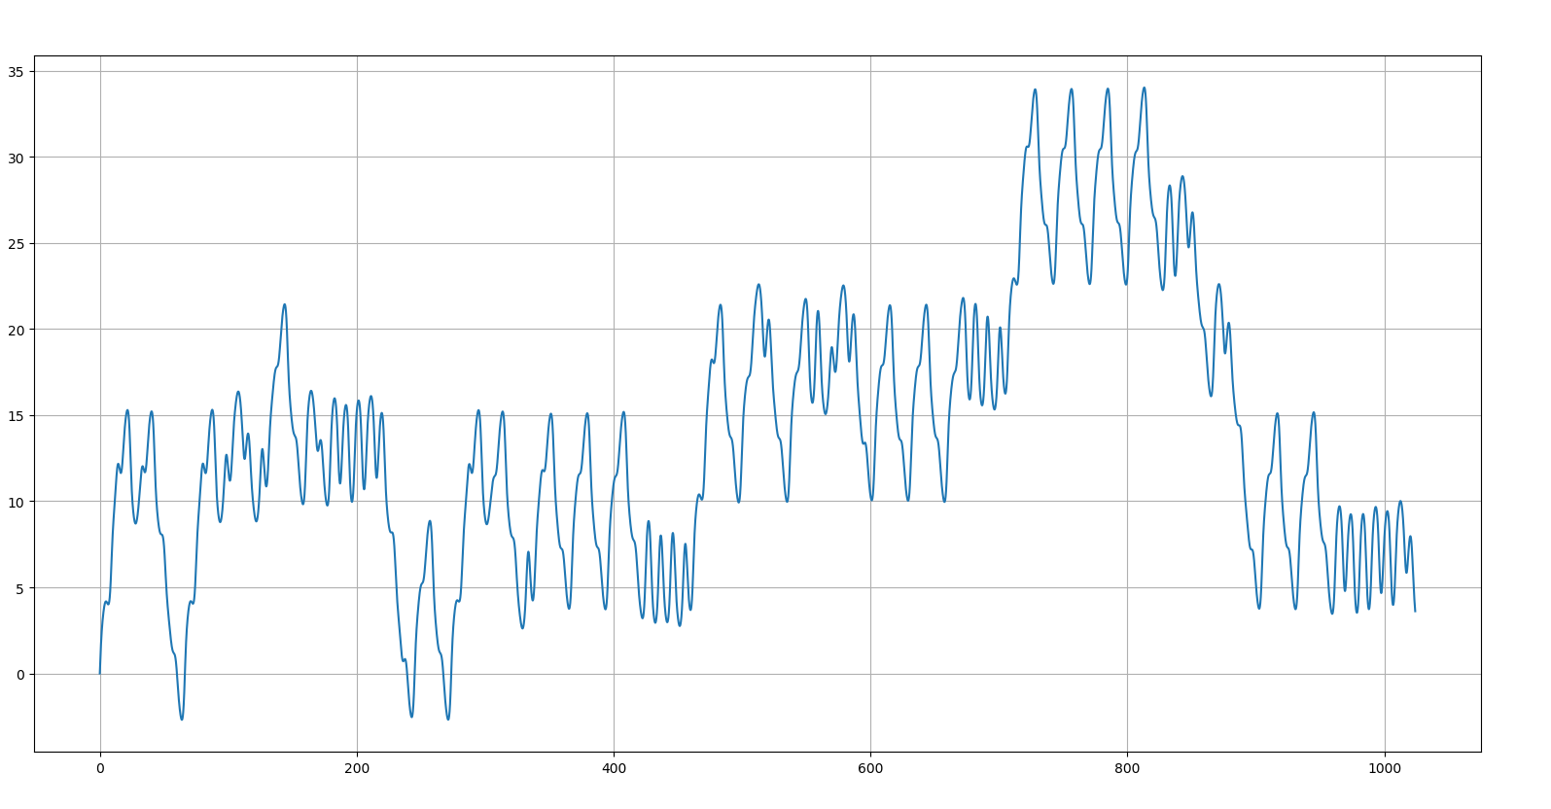
0~1024

Slide 23
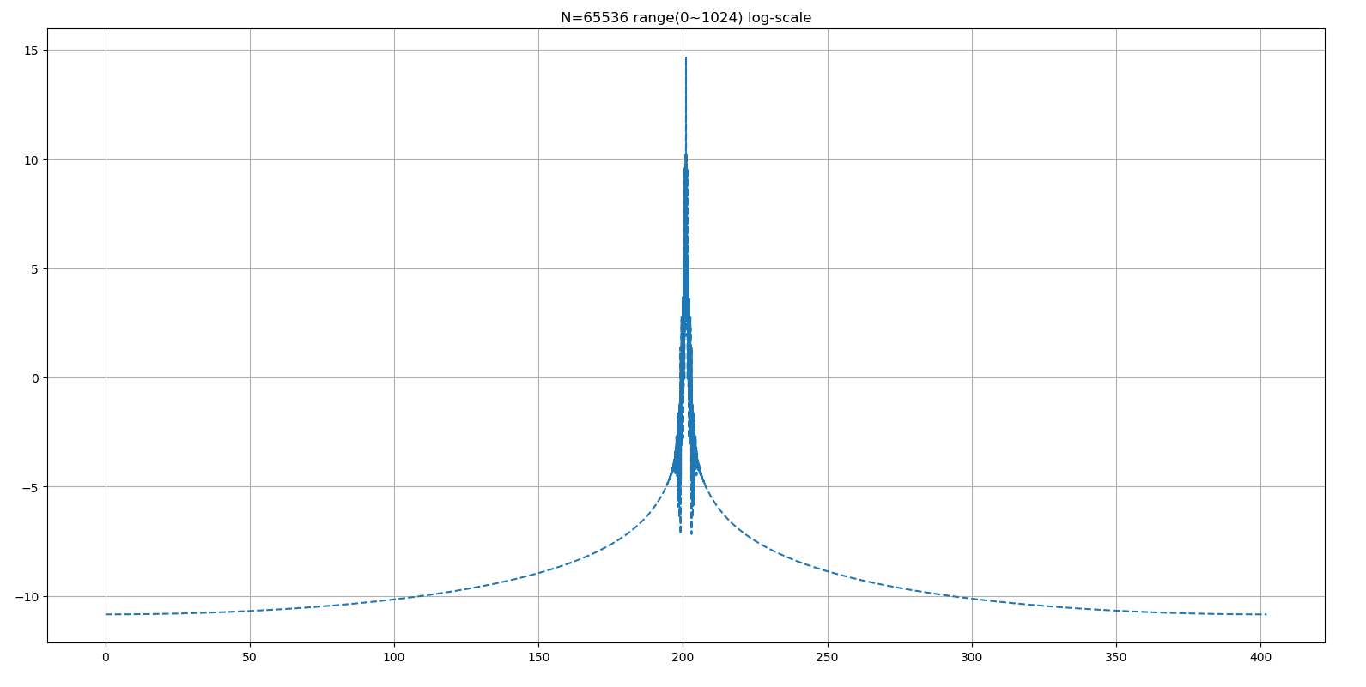

Slide 24
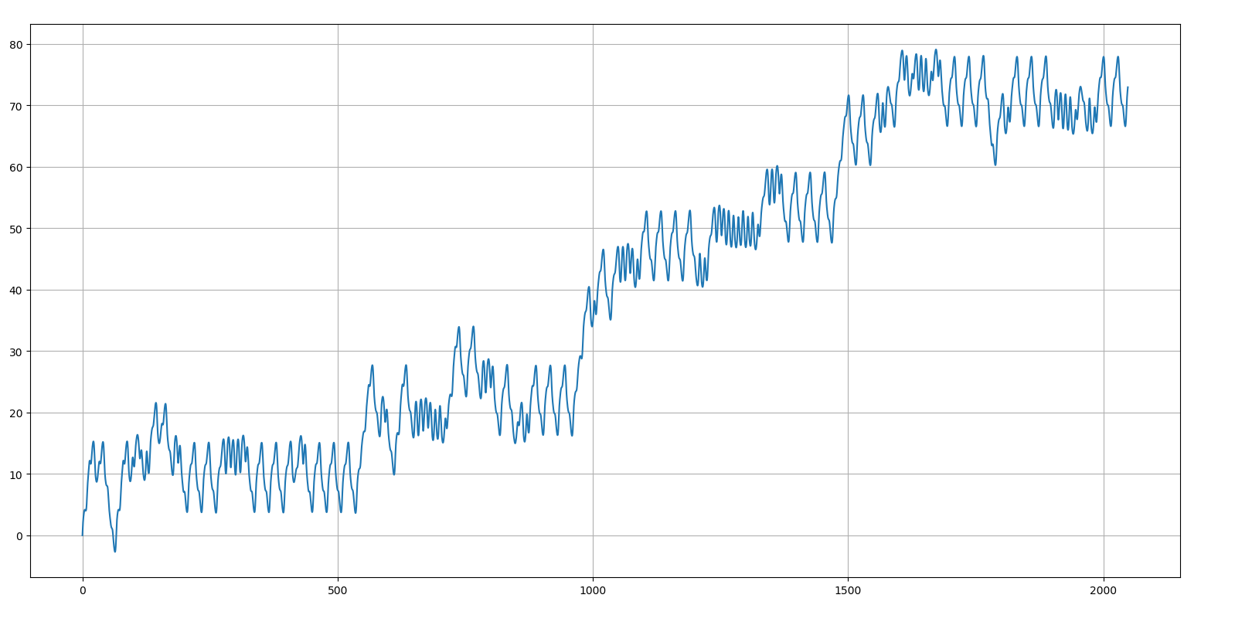
0~2048

Slide 25
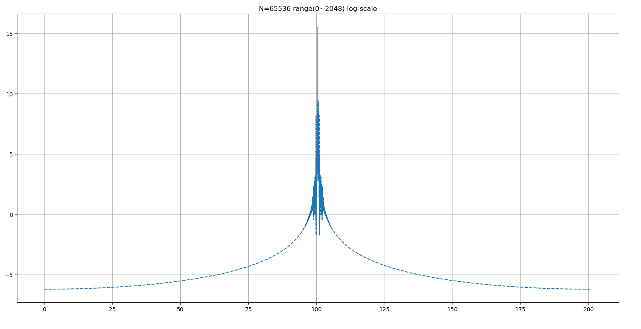

Slide 26
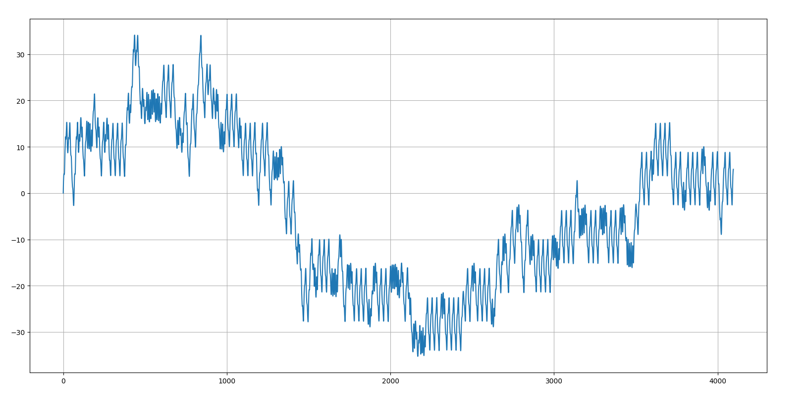
0~2048

Slide 27
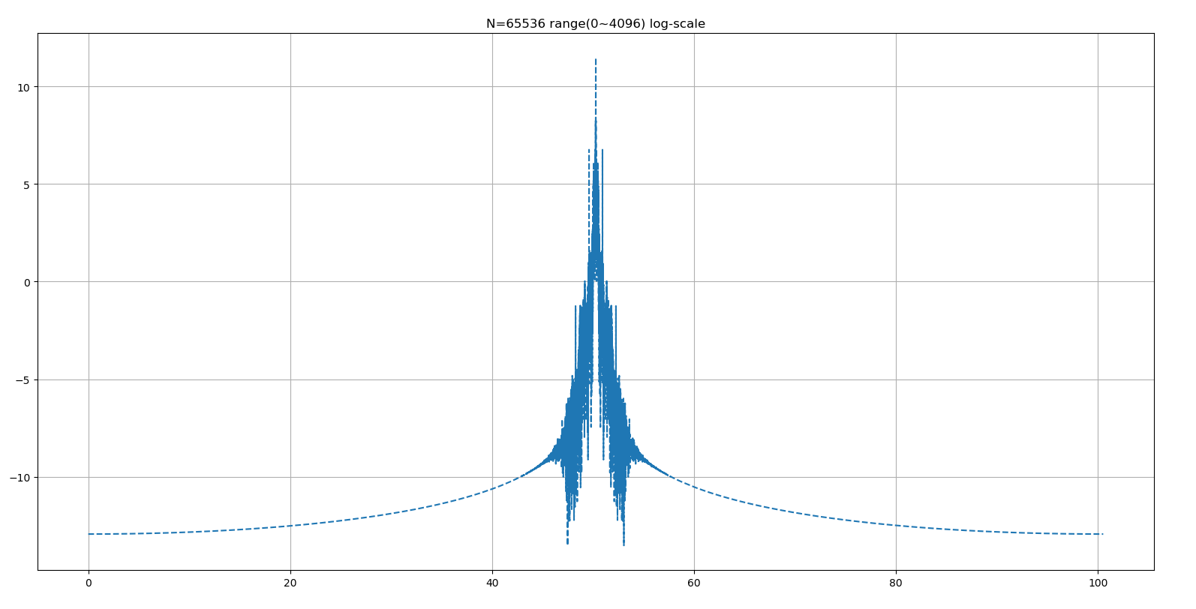

Slide 28
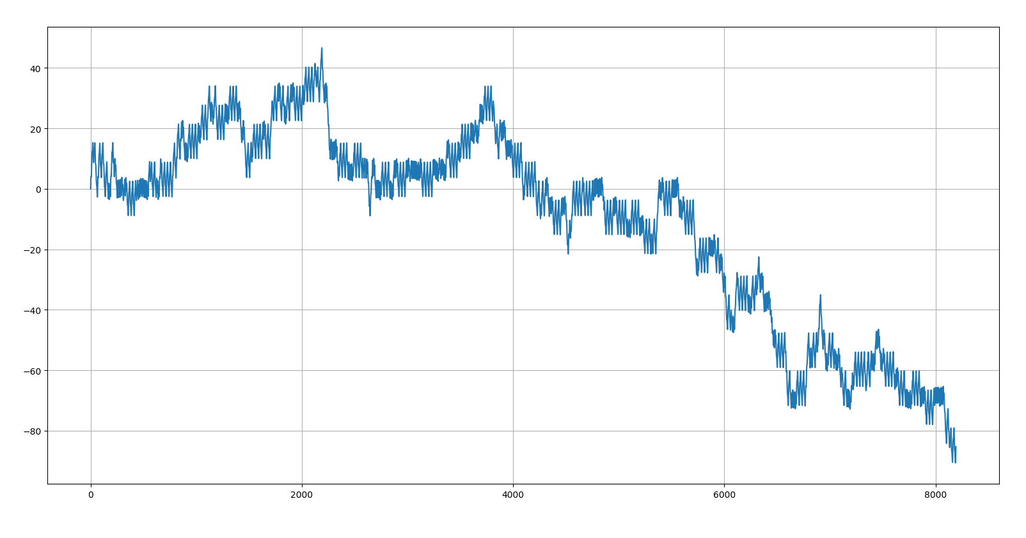
0~8192

Slide 29
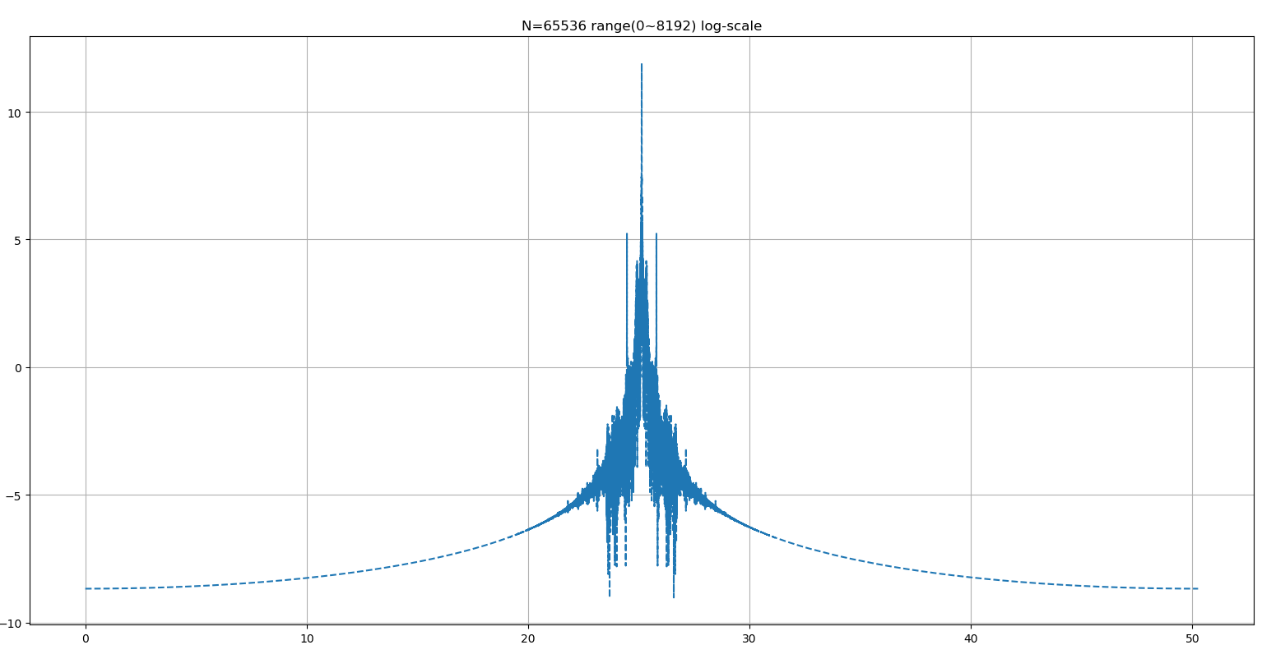

Slide 30
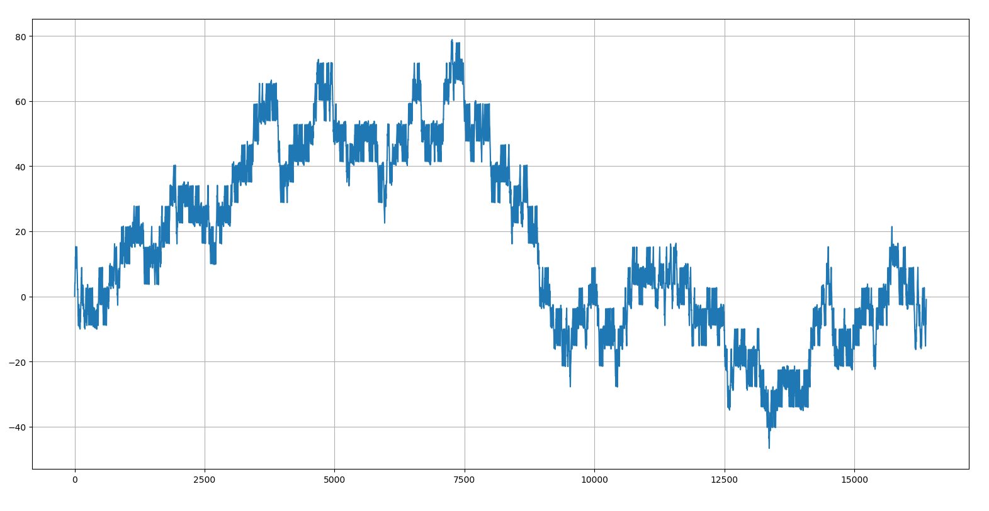
0~16834

Slide 31
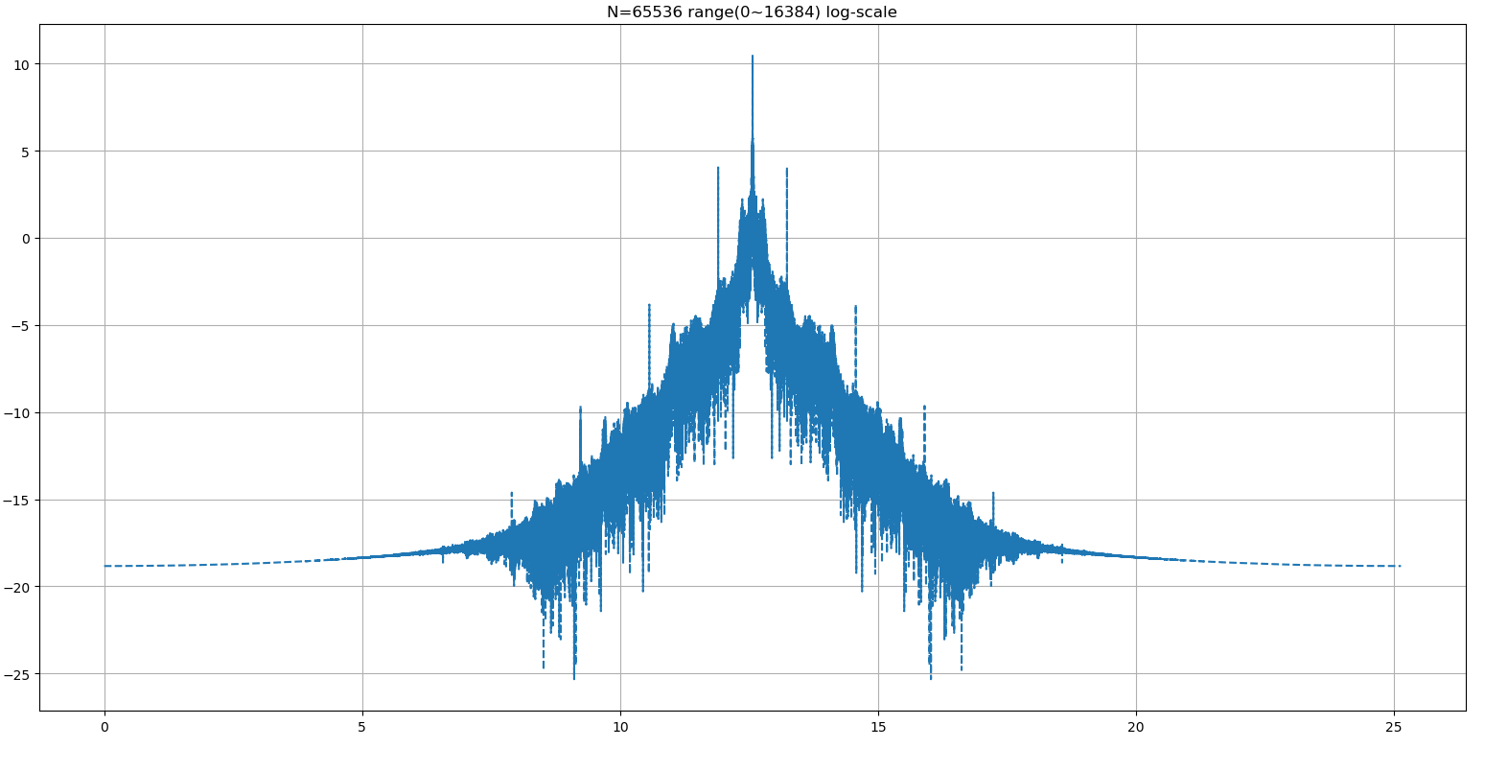

Slide 32
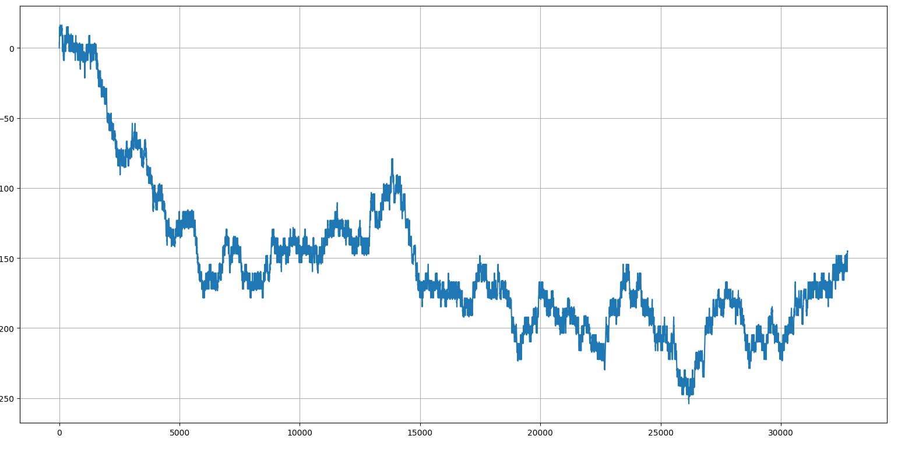
0~32768

Slide 33
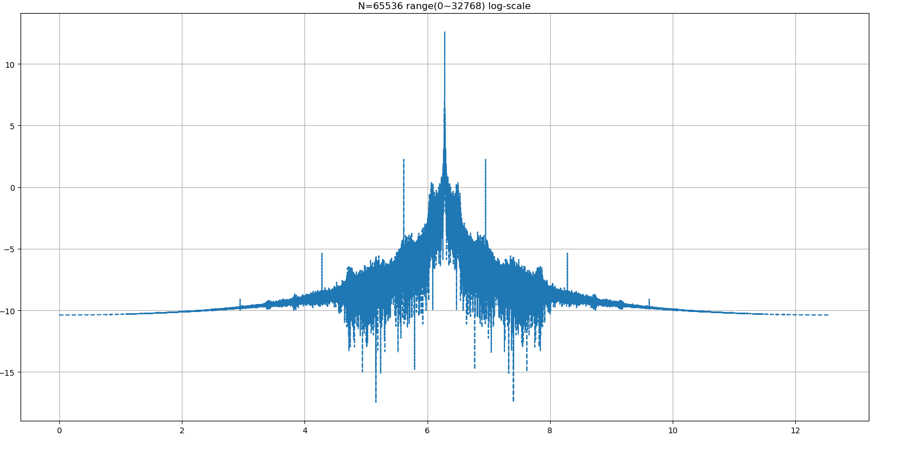

Slide 34
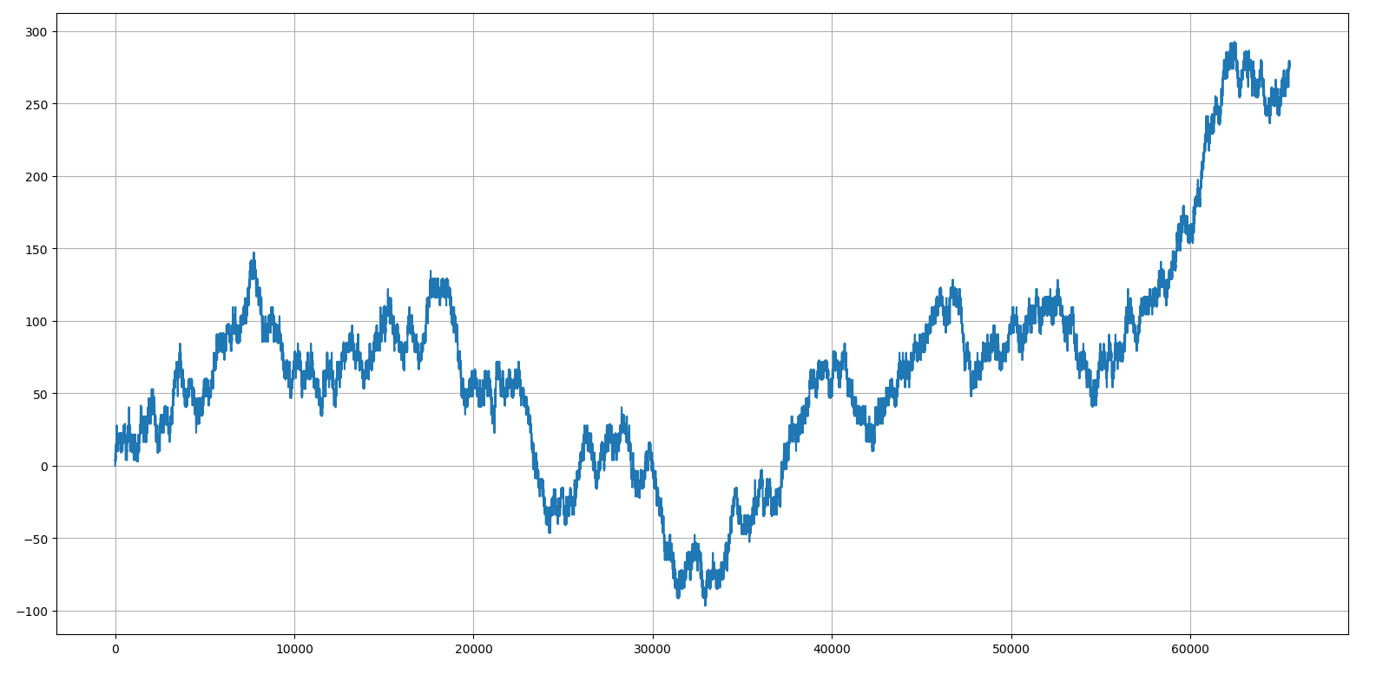
0~32768

Slide 35
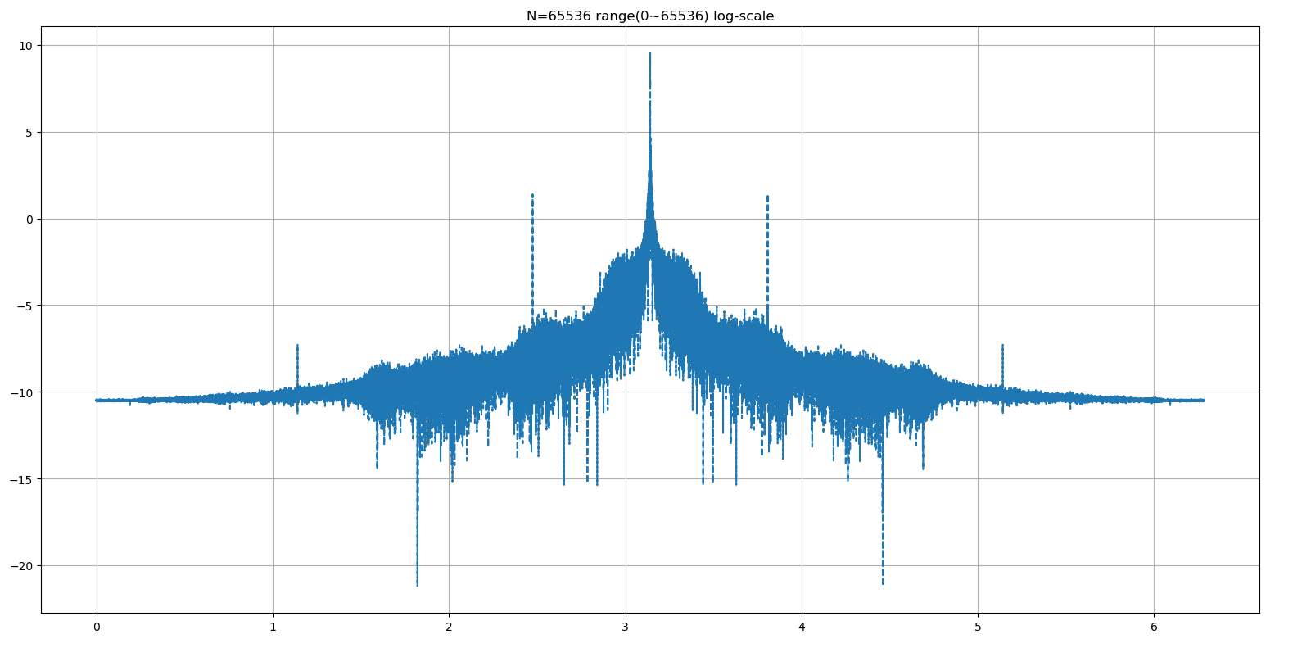

Slide 36
Fixed range
In the following figure, we will fix the range to (1~2^8)
B = 0.9

Slide 37
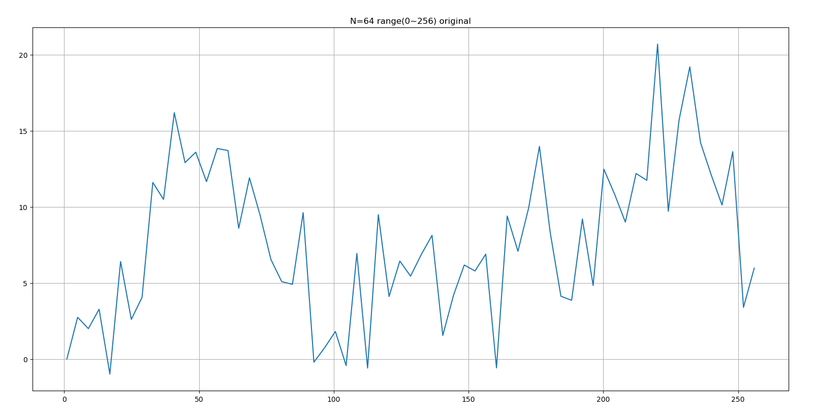

Slide 38
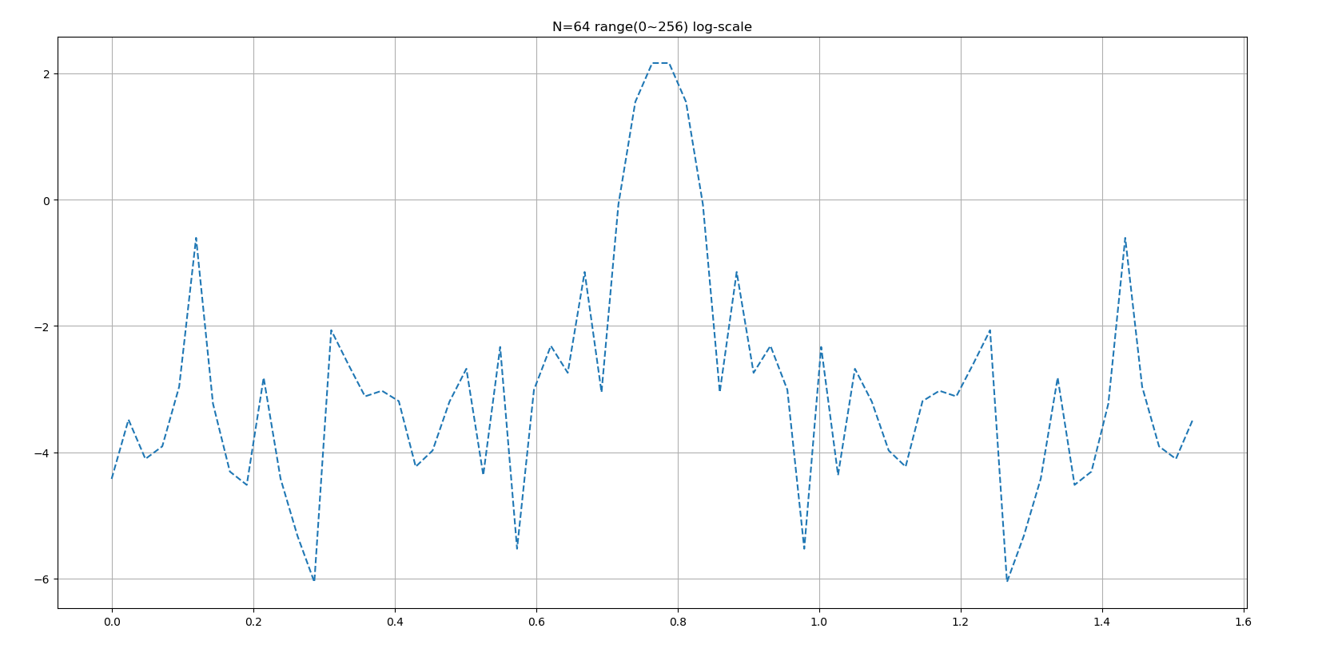

Slide 39
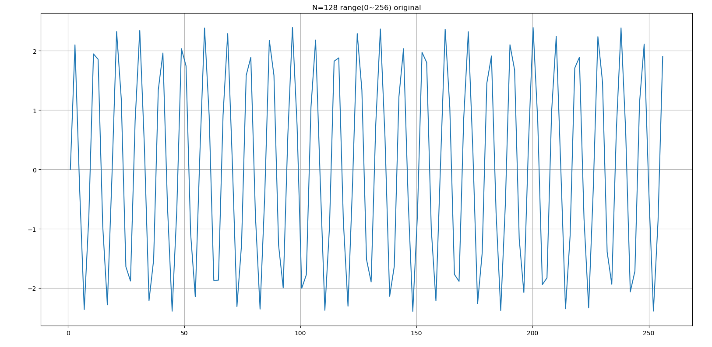

Slide 40
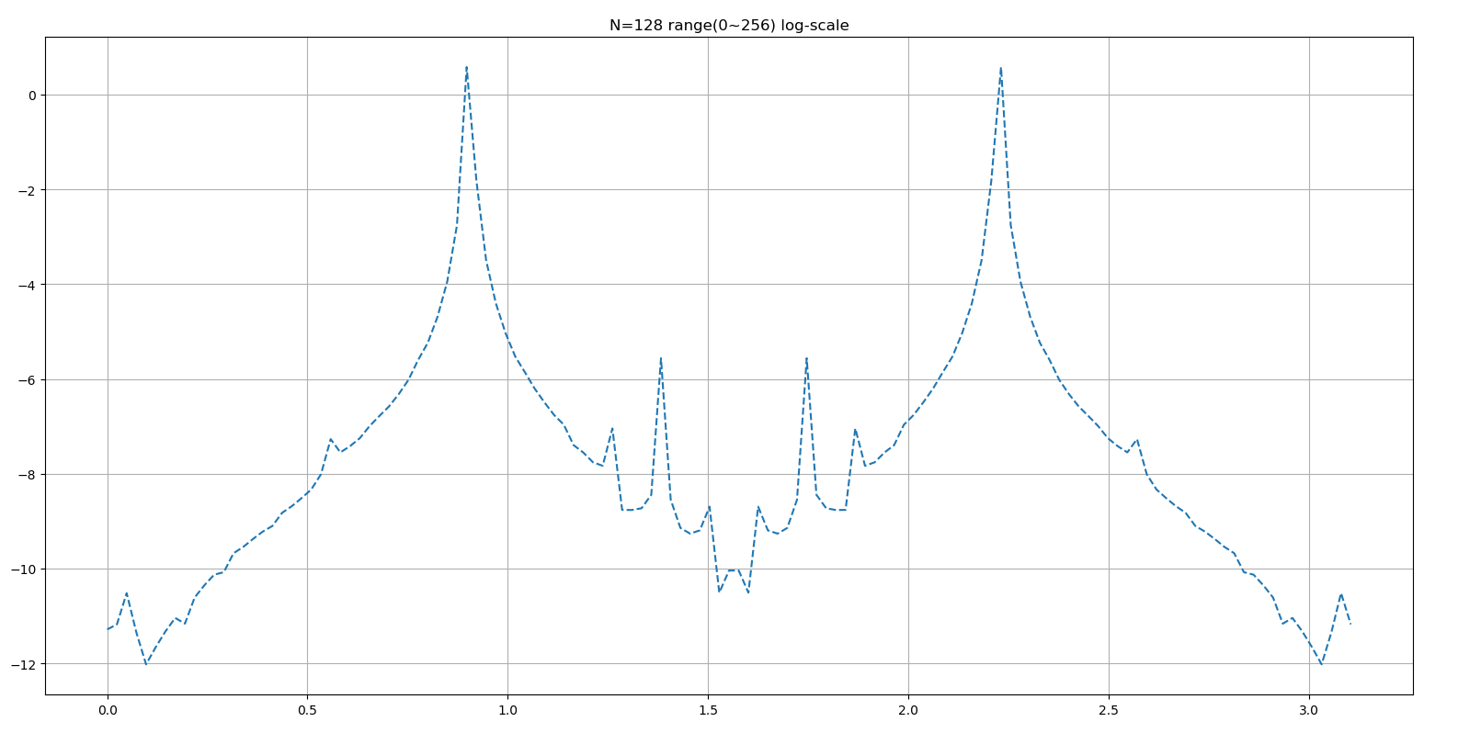

Slide 41
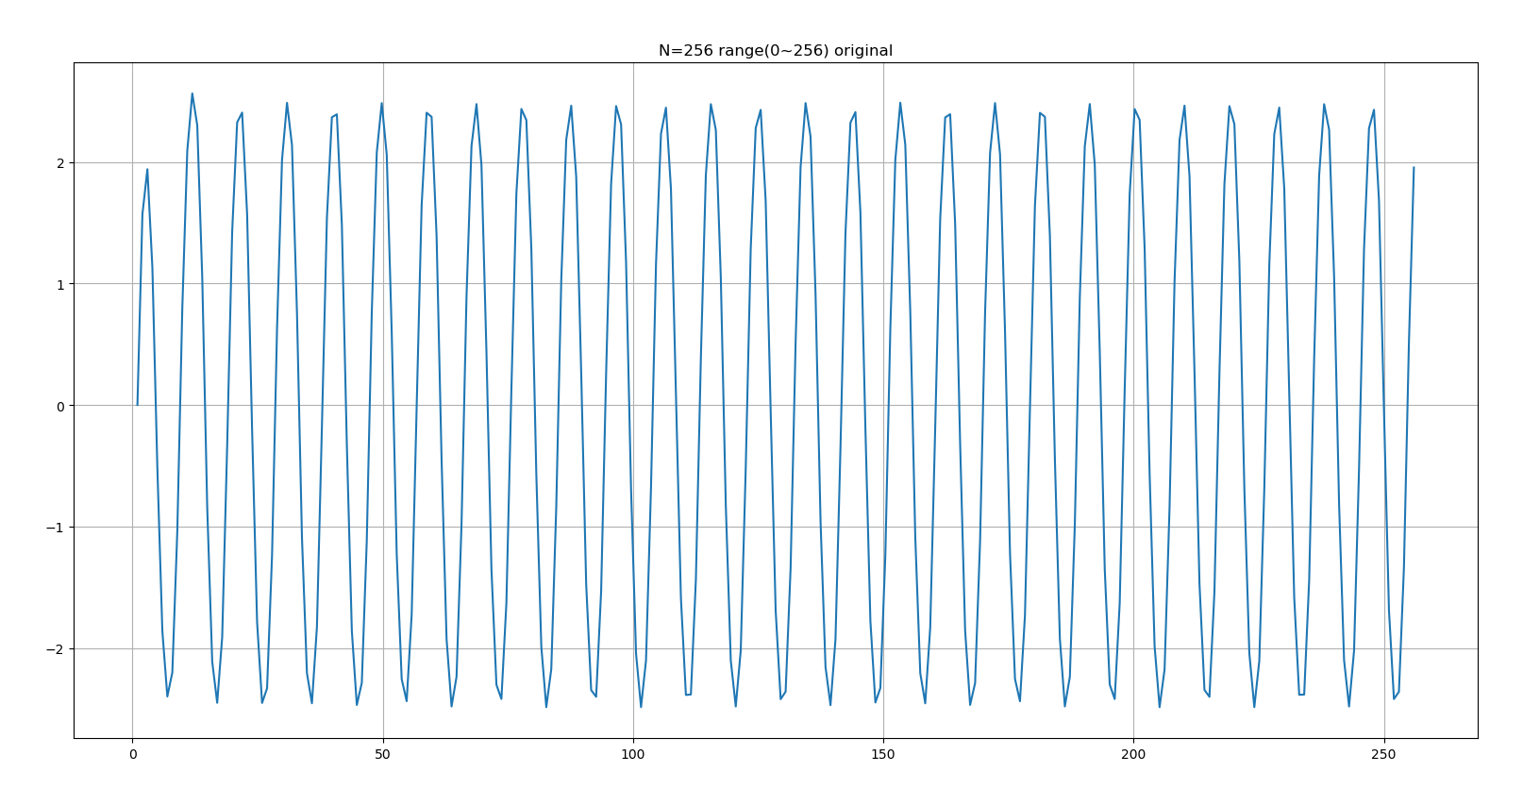

Slide 42
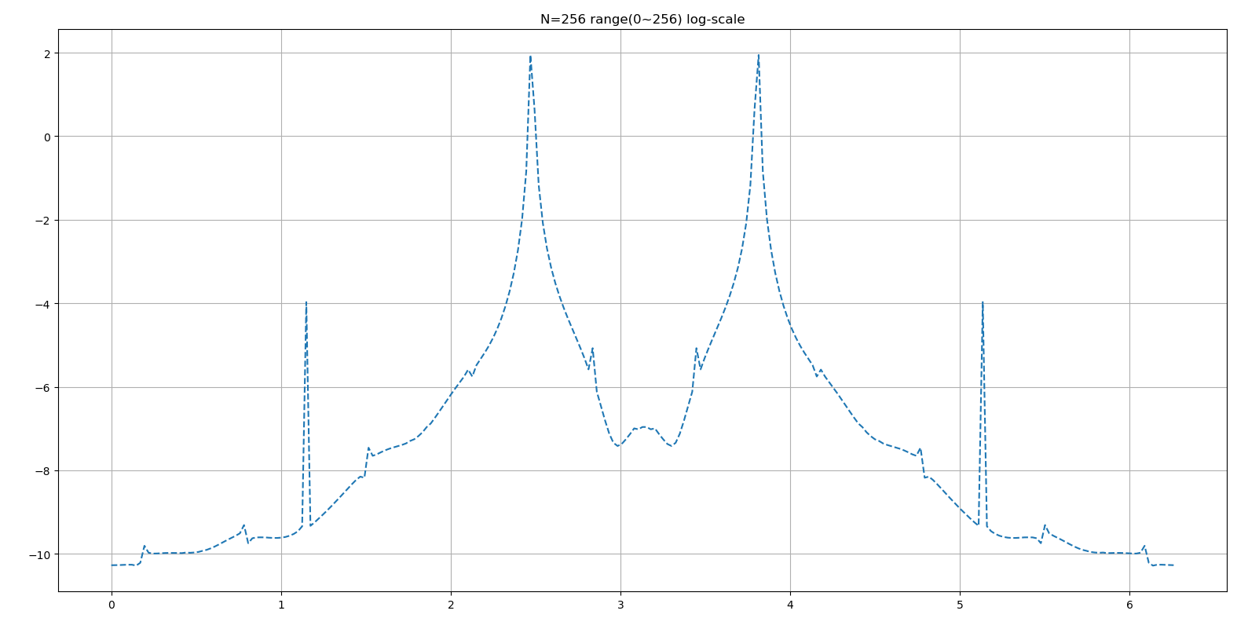

Slide 43
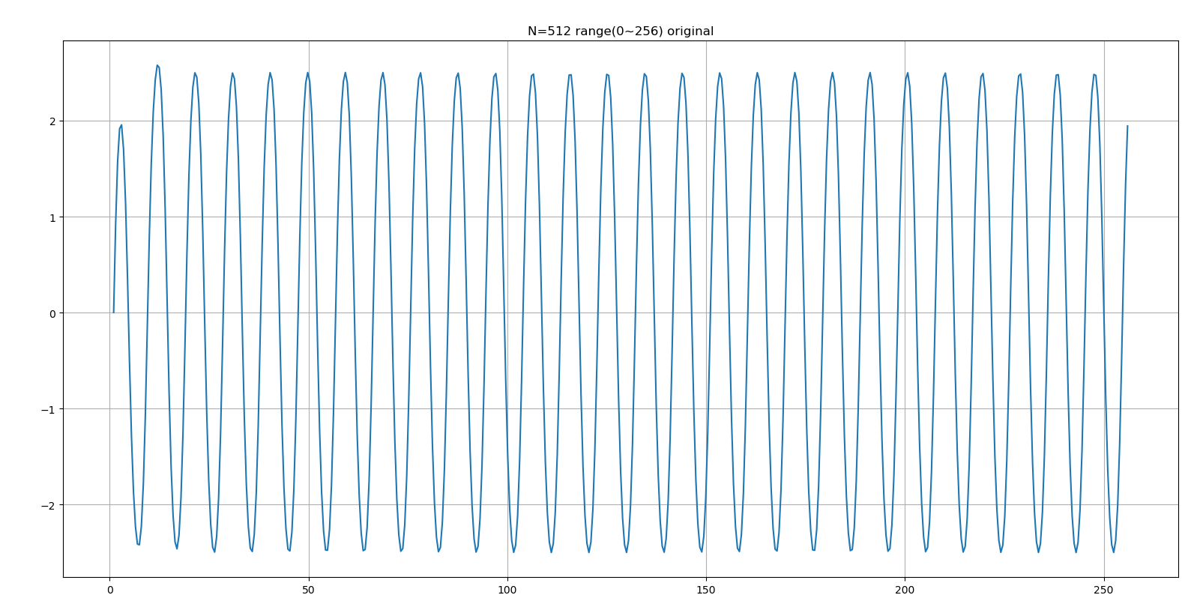

Slide 44
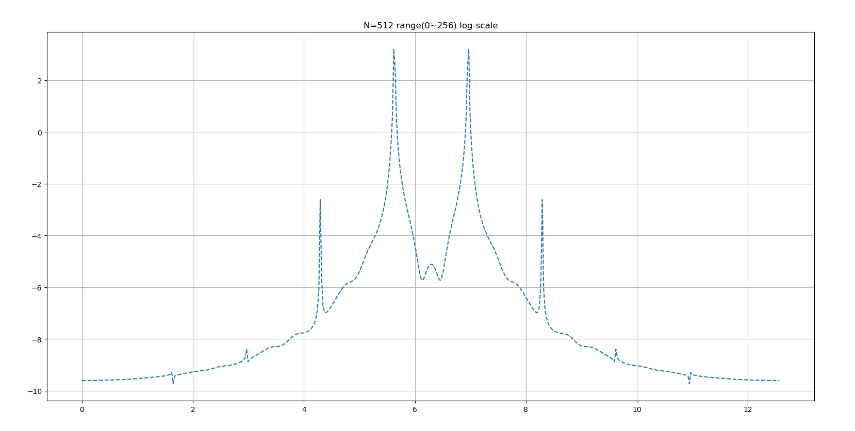

Slide 45
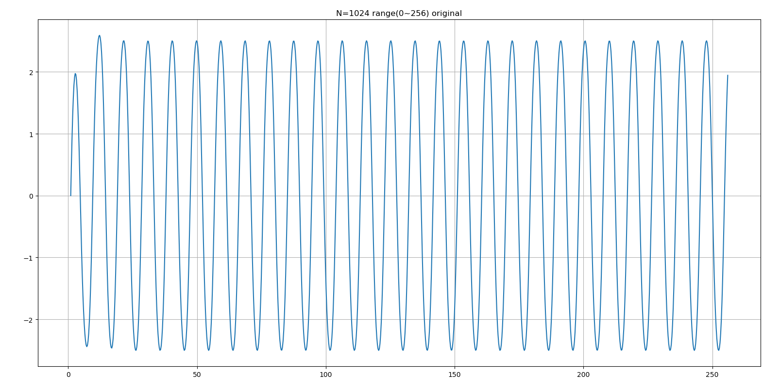

Slide 46
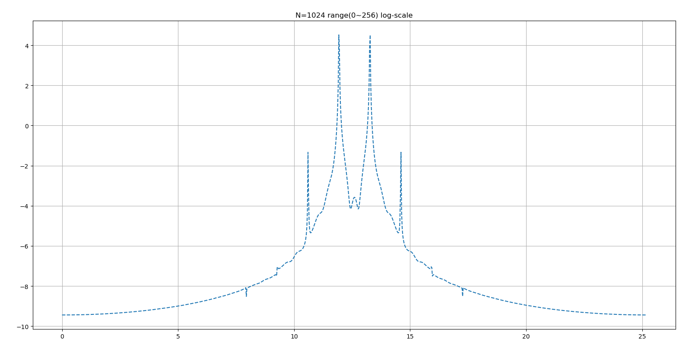

Slide 47
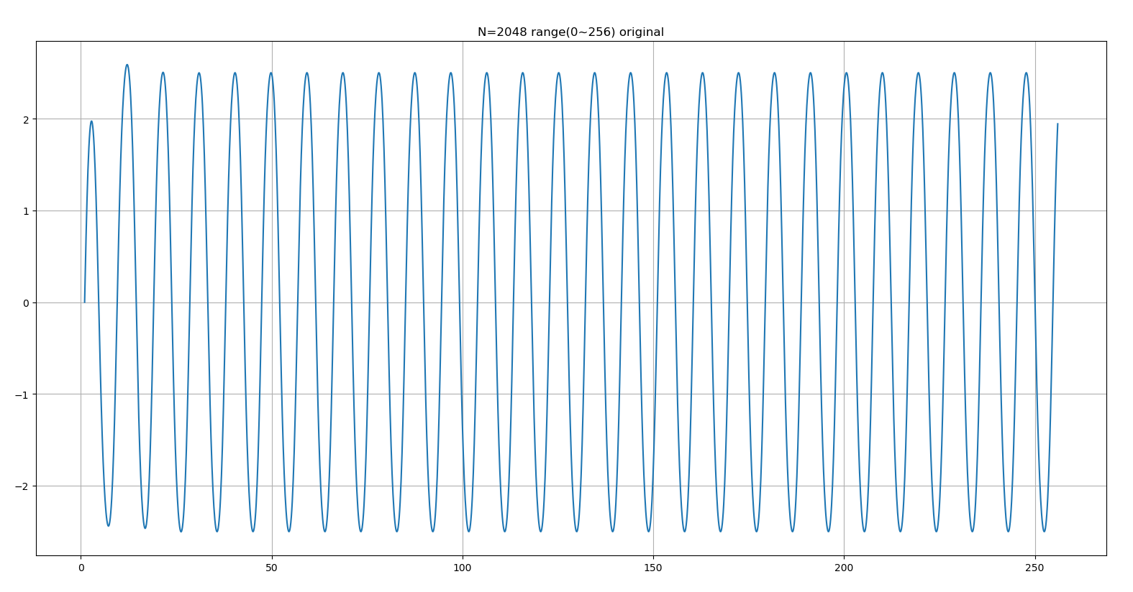

Slide 48
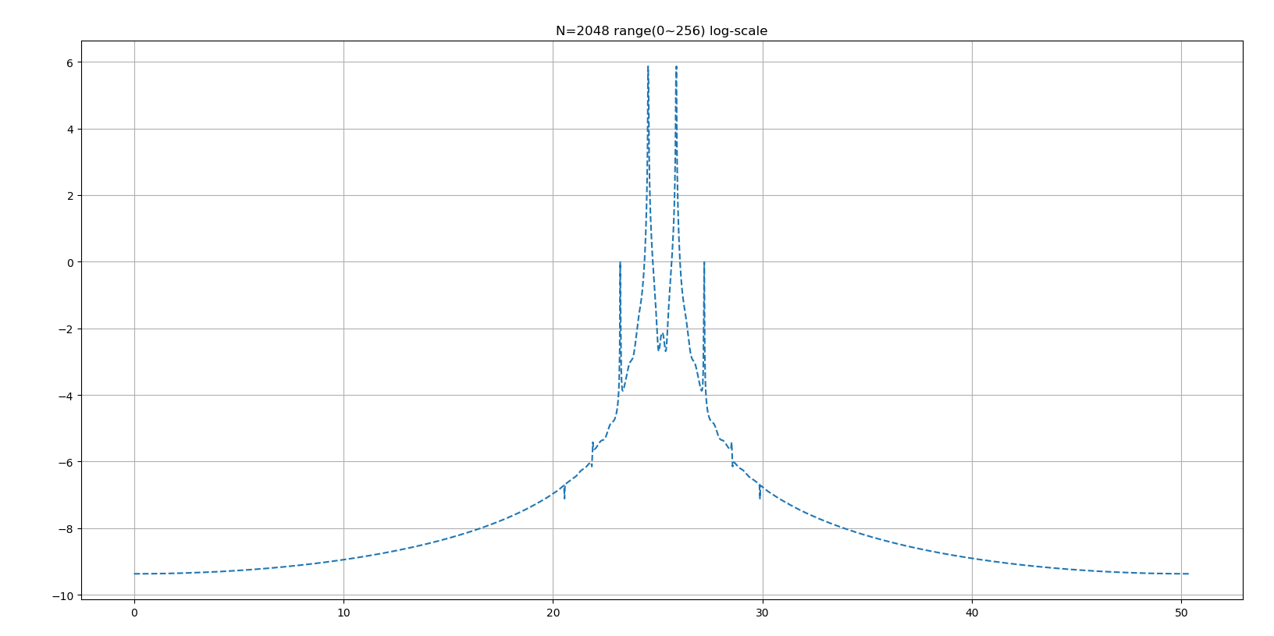

Slide 49
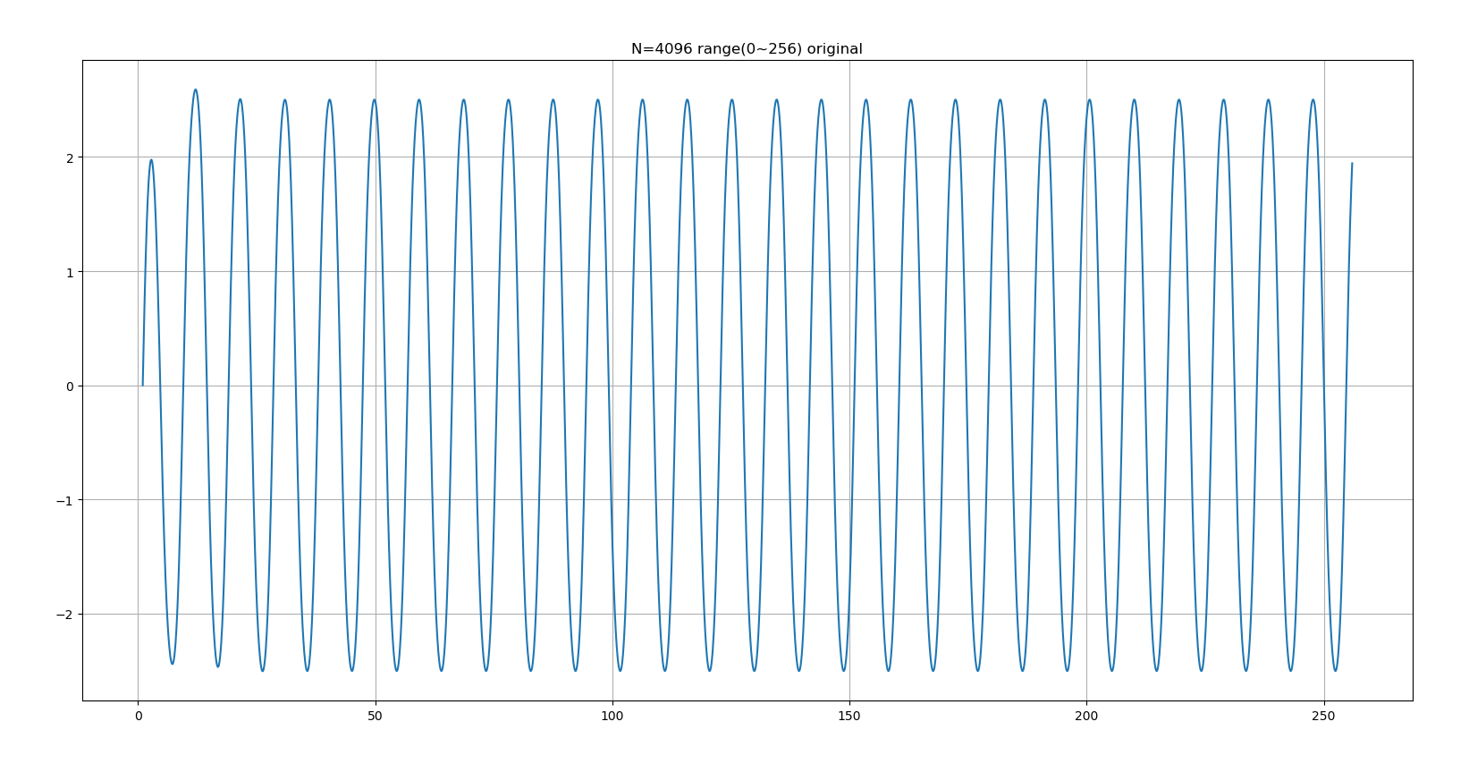

Slide 50
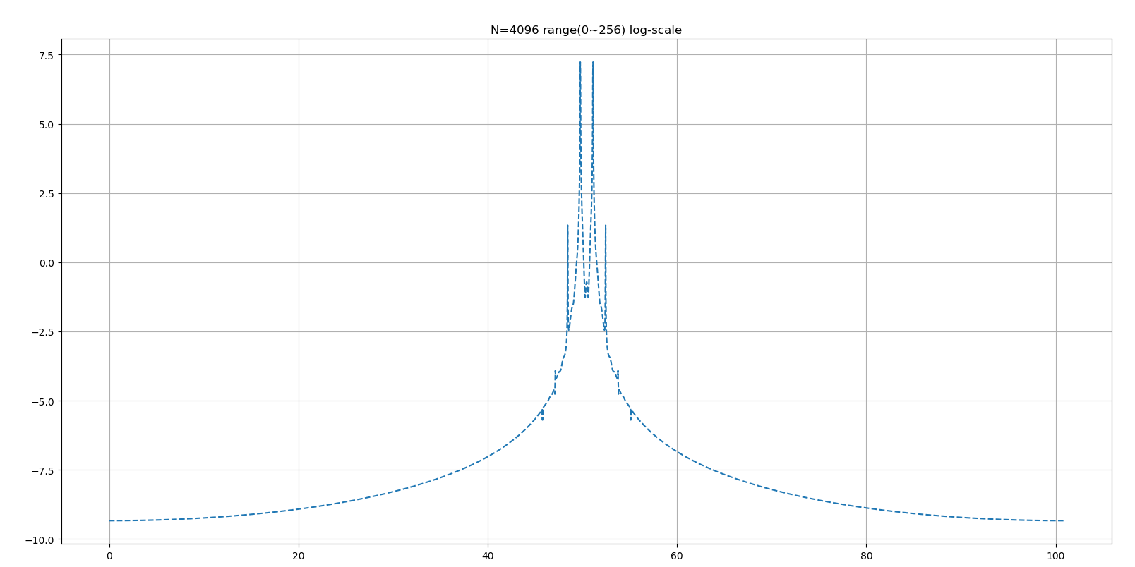

Slide 51
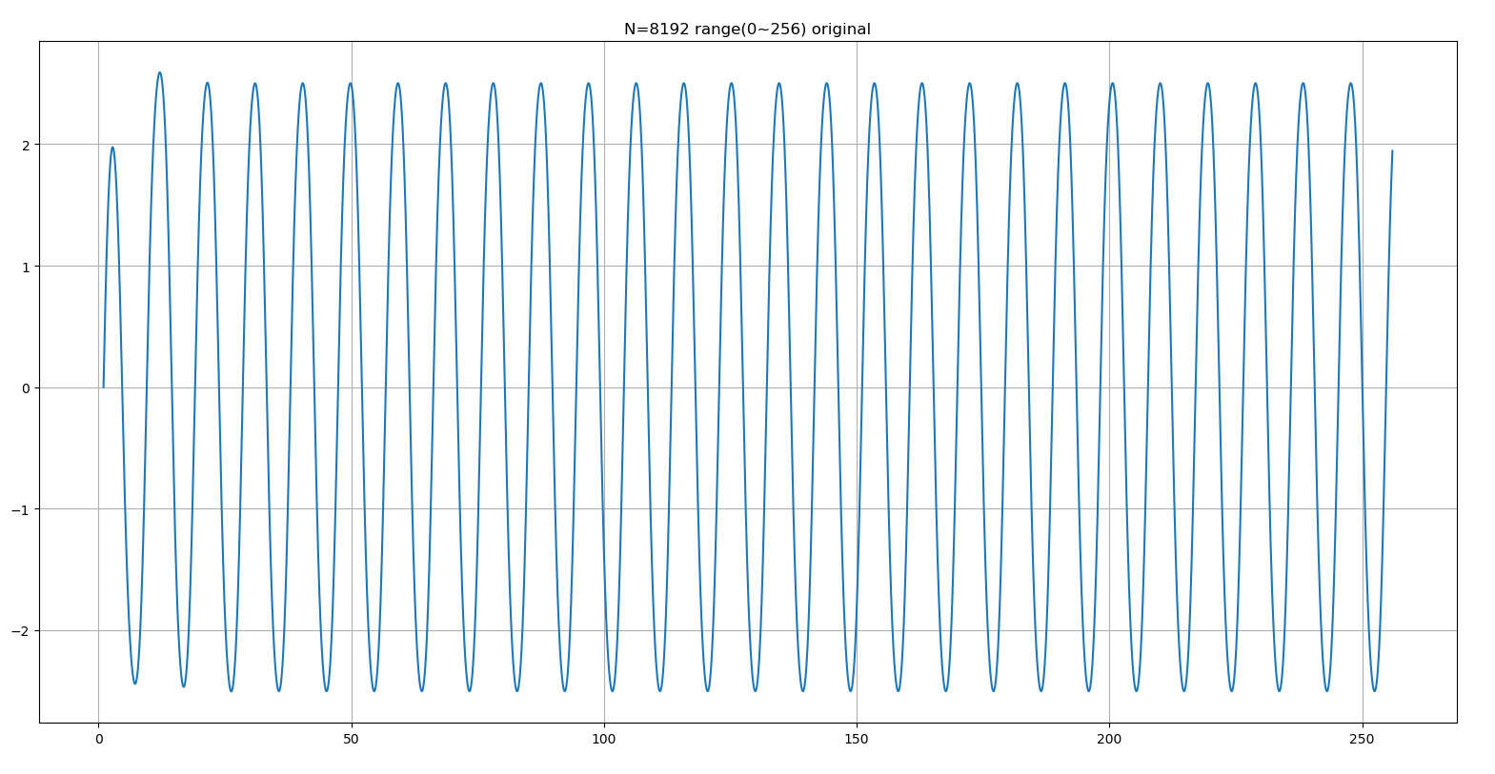

Slide 52


Slide 53


Slide 54


Slide 55


Slide 56


Slide 57


Slide 58


Slide 59
Fixed range
In the following figure, we will fix the range to (1~2^8)
B = 1.15

Slide 60


Slide 61


Slide 62


Slide 63


Slide 64


Slide 65


Slide 66


Slide 67


Slide 68


Slide 69


Slide 70


Slide 71


Slide 72


Slide 73


Slide 74


Slide 75


Slide 76


Slide 77


Slide 78


Slide 79


Slide 80


Slide 81


